Slide 1
MSE1065: Lab 4
Case study #2: Predicting steel fatigue using ML approaches

Slide 2
Learning objectives for this lab
Utilize ML based regression analysis to predict fatigue life of steel

Slide 3
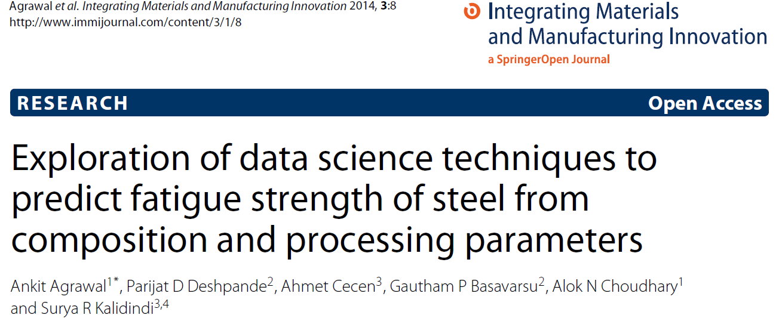
Source
Data availability:
National Institute of Materials Science (NIMS, Japan) http://smds.nims.go.jp/fatigue/index_en.html

Slide 4
Dataset
NIMS MatNavi
Carbon and low-alloy steels, carburizing steels and spring steels
Features:
Chemical composition - %C, %Si, %Mn, %P, %S, %Ni, %Cr, %Cu, %Mo (all in wt. %)
Upstream processing details - ingot size, reduction ratio, non-metallic inclusions
Heat treatment conditions - temperature, time and other process conditions for normalizing, through-hardening, carburizing-quenching and tempering processes
Mechanical properties - YS, UTS, %EL, %RA, hardness, Charpy impact value (J/cm2), fatigue strength.

Slide 5
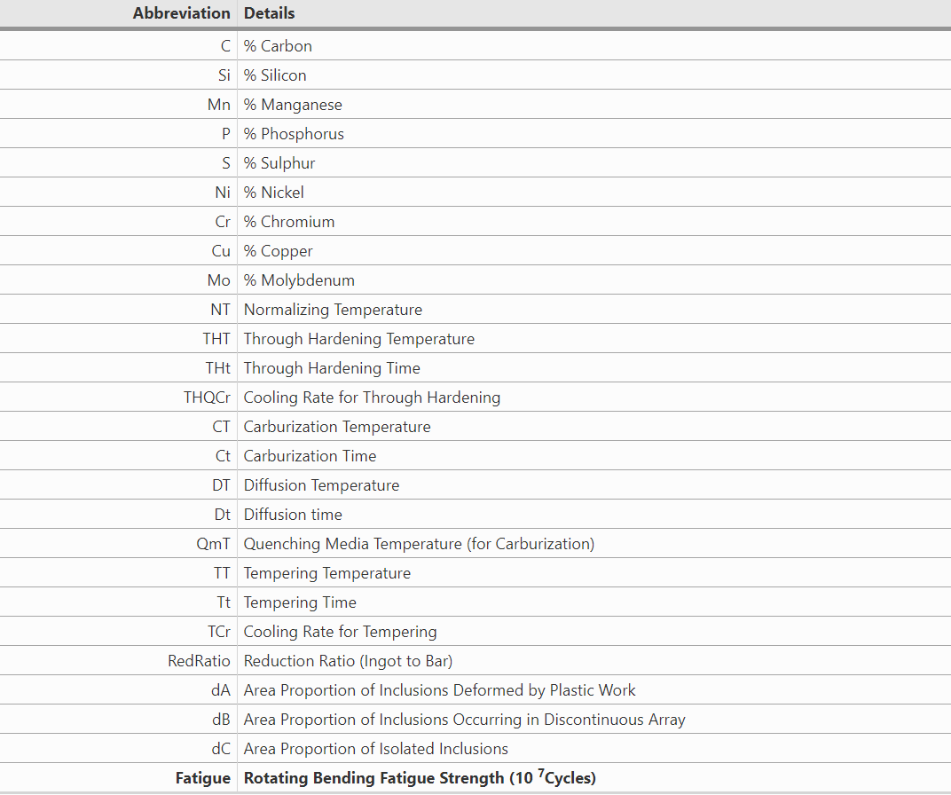
Feature engineering
437 instances/rows, 25 features/columns (composition and processing parameters), and 1 target property (fatigue strength)

Slide 6
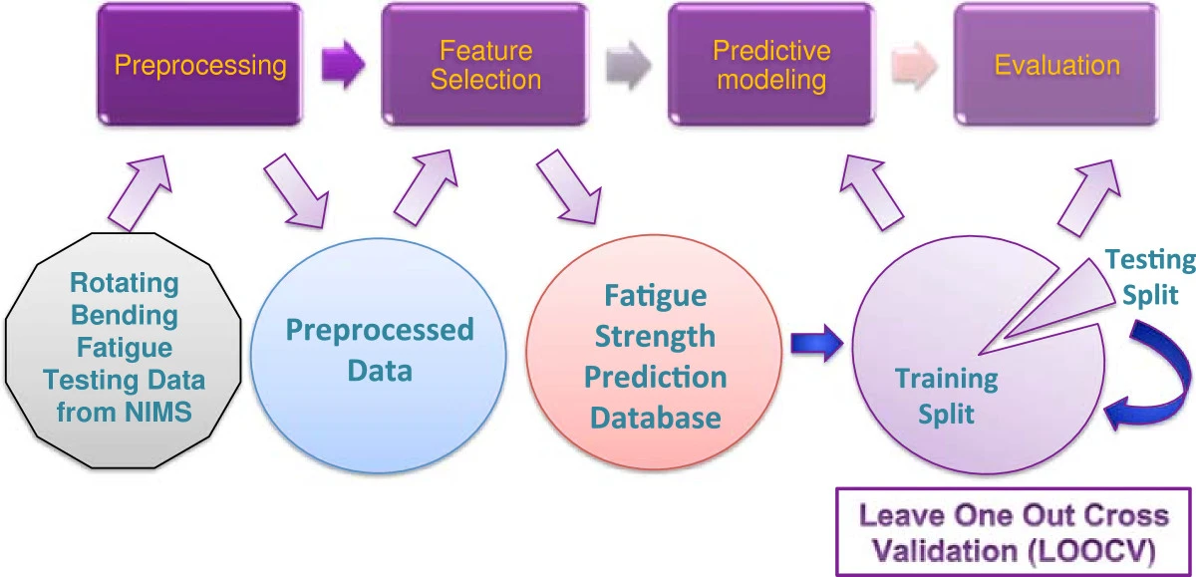
Notes:
Schematic of overall proposed approach to fatigue strength prediction of steels with knowledge discovery and data mining.

Slide 7
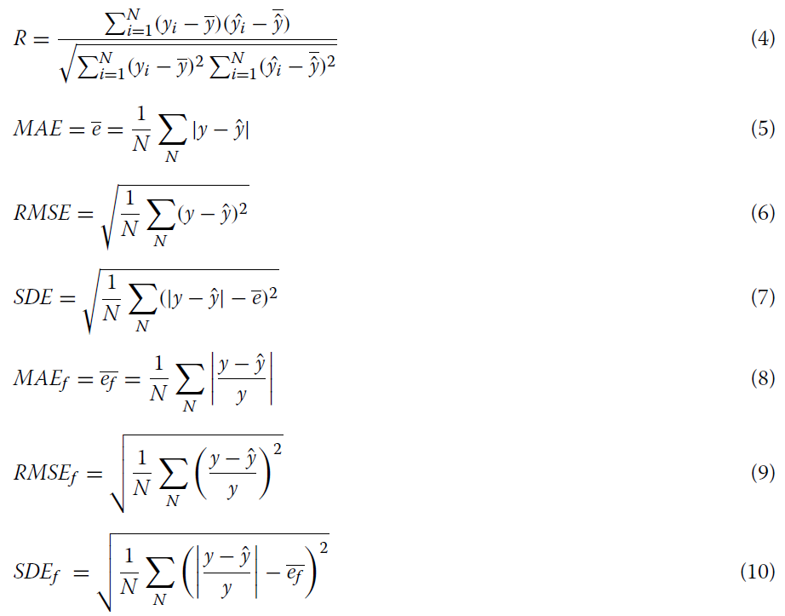
Assessment Criteria

Slide 8
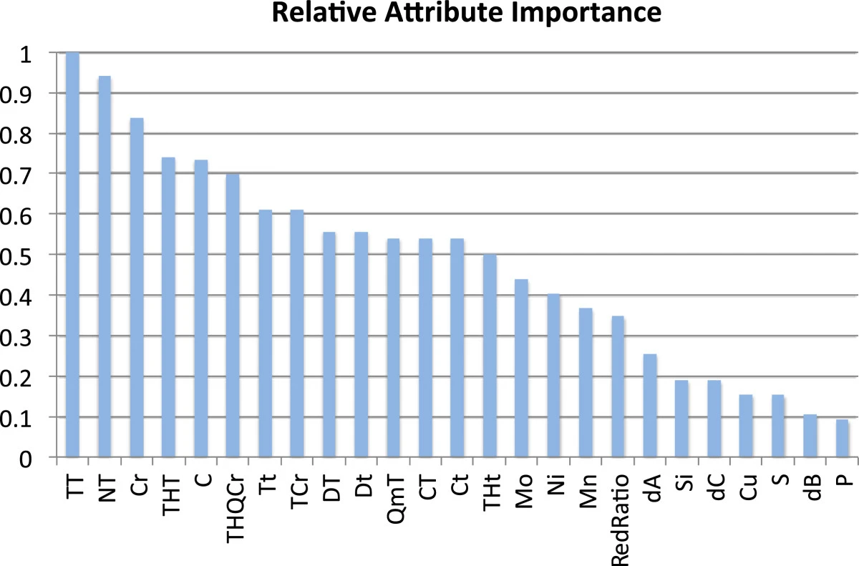
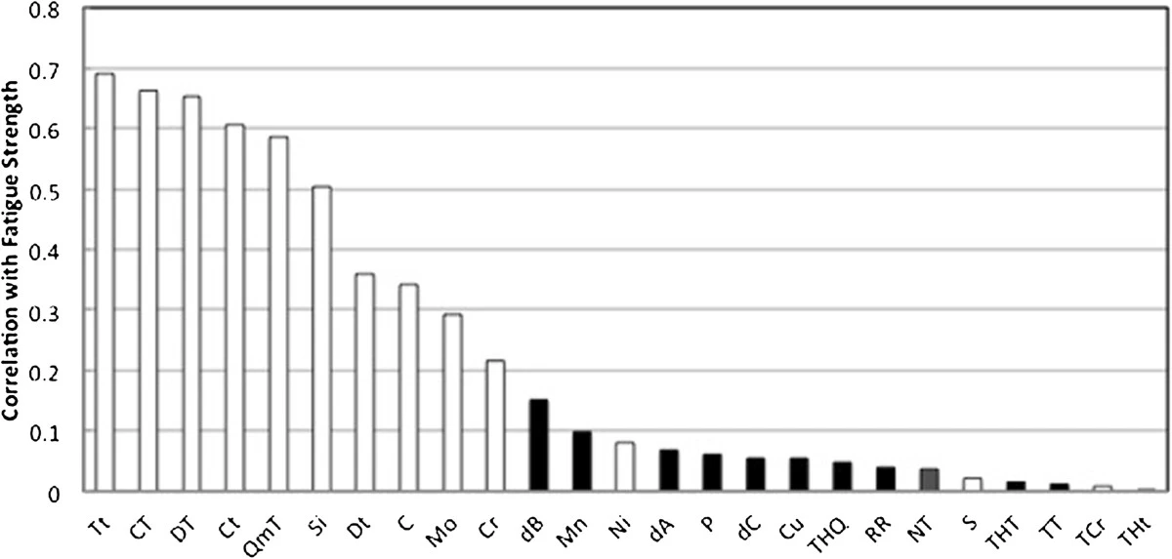

Slide 9
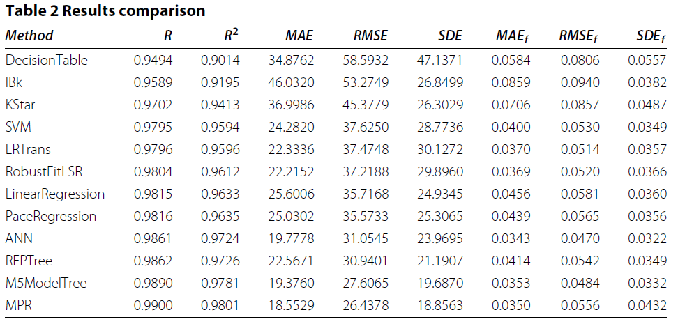
Performance of different ML approaches

Slide 10
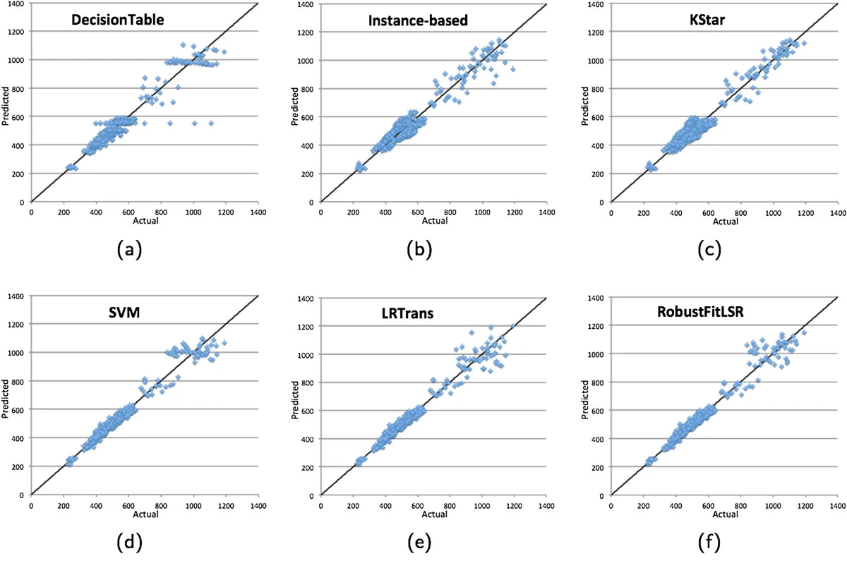
Scatter plots
Notes:
Scatter plots. Scatter plots for the 12 modeling techniques. X-axis and Y-axis denote the actual and predicted fatigue strength (in MPa) respectively. a) Decision Table; b) Instance-based; c) KStar; d) Support Vector Machines; e) Regression with Transformed Terms; f) RobustFit Regression; g) Linear Regression; h) Pace Regression; i) Artificial Neural Networks; j) Reduced Error Pruning Trees; k) M5 Model Trees; l) Multivariate Polynomial Regression.

Slide 11
What will you accomplish in the lab?
In this lab, we will apply three different linear regression models on steel dataset.
We will be using SKLearn's LinearRegression class to fit linear models and compute mean absolute error.
We will extend our linear model by including regularization using SKLearn
In the last section, we will implement model for sparse linear regression using SKLearn, namely LASSO
This model can be useful to select features as it results into most weights to be zero

Slide 12
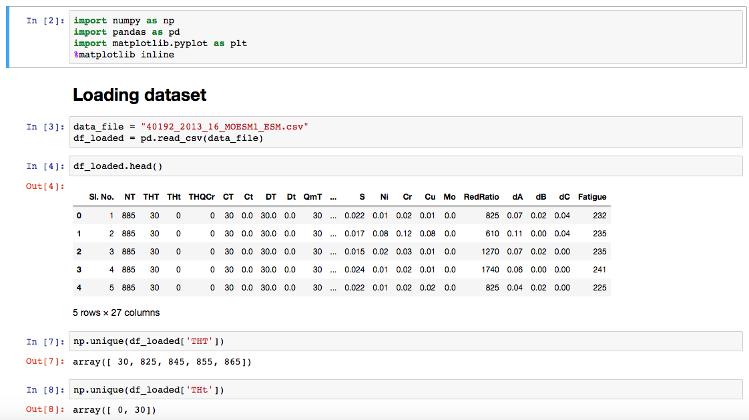
Lab notebook

Slide 13
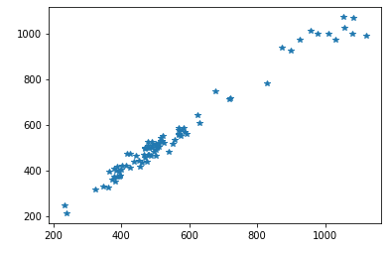
Expected output

